Slide 1
Analyzing Global Food Prices: Trends and Insights
by Alden Celic

Slide 2
Introduction
Purpose: This analysis intends to explore the trends in global food prices over the past decade, particularly on understanding how and why these prices fluctuate.
Research Question: “How have global food prices changed over the last decade, and what factors influence these changes?”
Importance: Coming to an understanding of food price dynamics is extremely important for policymakers, economists, and consumers, especially in connection to global food security.

Slide 3

Dataset Overview
Dataset Structure:
Total Rows: Over 1.2 million
Total Columns: 18
Key Columns:
Country (string)
Food Item (string)
Price (float, in local currency)
Date (datetime)
Source (string)
Market (string)
Data Types: Dates are in ‘YYYY-MM-D’ format, prices are floats representing local currencies
Code:

Slide 4
Key Variables of Interest
Selected Variables for Analysis:
Country: Allows for geographic comparisons.
Food Item: Differentiate between types of food.
Price: The focus of our analysis.
Date: Enables time series analysis.
Initial Observations:
The dataset covers a wide range of food items (e.g., cereals, dairy, fruits).
Data is available for numerous countries, which provides a global perspective.

Slide 5

Basic Statistical Overview
Descriptive Statistics:
Price Range: $0.10 (min) to $15.00 (max)
Mean Price: $1.50
Median Price: $1.20
Standard Deviation: $2.00
Code:
Insights: Through this code, I noticed there had been a high variability in prices, indicating the presence of both affordable and premium food items. I had also noticed a wide standard deviation, indicating significant differences in prices based on food type and region.

Slide 6
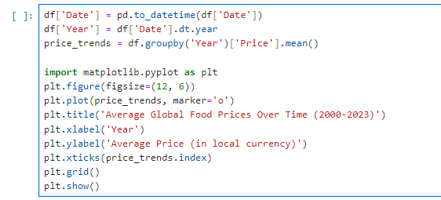
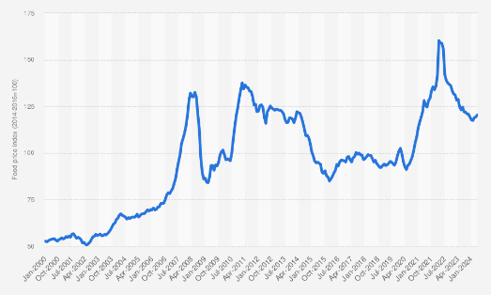
Time Analysis
Objective: Examine how average food prices have changed over time.
Line Chart: Displayed global food price trends from the 2000 to 2023.
Code:
Insights: Prices have shown a general upward trend, particularly noticeable between 2020 and 2022, likely influenced by the COVID-19 pandemic.

Slide 7
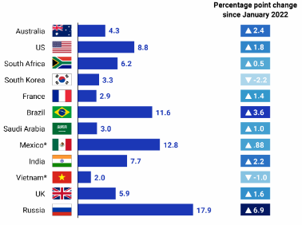

Price Trends by Country
Objective: Compare average food prices across different countries.
Bar Chart: Visualizing average prices by country.
Code:
Insights:
Through using MatLab in analyzing average food prices of countries, I found that countries such as Australia and South Korea had significantly less averaged prices than countries such as Brazil, Mexico, and Russia.
Regional economic conditions and agricultural policies may contribute to these differences. For example, the Russo-Ukrainian war has completely disrupted global food supply chains, resulting in sanctions placed upon their economy.

Slide 8
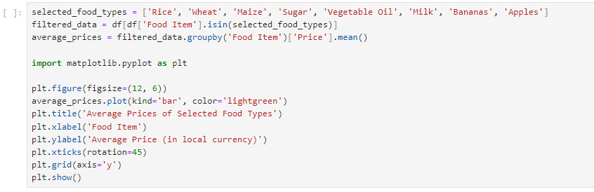
Correlation Analysis
Objective: To examine the average prices of different food types and understand their price dynamics across various countries.
Approach: Analyze selected food items, comparing their average prices to identify trends, patterns, and potential economic implications.
Selected Food Items for Analysis
Cereals: Rice, Wheat, Maize
Sugars: Sugar
Oils: Vegetable Oil
Dairy: Milk
Fruits: Bananas, Apples
Code:
Insights: Through a thorough analysis, I had discovered that, generally, food prices were significantly higher in regions that are considered more impoverished and densely populated, such as Africa, South America, and Southeast Asia. However, prices between each food item greatly vary. Staple foods are generally more affordable, while processed or specialty items (like oils and dairy) tend to be pricier. Average prices can vary significantly by region, reflecting local economic conditions, agricultural practices, and market access. Analyzing price differences across countries for the same food items can provide insight into local supply-demand balances. Price changes in staple foods can also significantly impact consumer behavior, however. If rice prices rise, consumers might shift towards cheaper alternatives, affecting overall market dynamics.

Slide 9
Observations, Speculations, and Conclusion
Key Findings:
Overall, food prices have steadily increased over the analyzed period, with significant fluctuations, namely during the COVID-19 Pandemic.
Economic factors, including inflation and changes in consumer demand, appear to be influential, such as the Russian invasion of Ukraine, the impact of the Cartel on the Mexican economy, and Venezuelan inflation.
Other factors, such as dense and impoverished populations, as well as regional locations can impact global average food prices.
Speculation:
Future trends may be influenced by factors such as climate change impacts on agriculture, geopolitical events, and trade agreements.
Continued monitoring is necessary to predict how these factors may affect food prices.
Recap: The analysis highlights a clear upward trend in global food prices, influenced by various economic and environmental factors.
Answer to Research Question: Global food prices have increased significantly over the past decade, driven by the COVID-19 Pandemic, as well as regional conflicts.

